Slide 1
Grab Problem Statement Theme: Economic empowerment through AI
Team: Hacklaicai

Slide 2

TABLE OF CONTENTS
01
04
02
05
03
06
Problem statement
Personalized strategies
Solution architecture
Interaction design
Data utilization
Sample chat case

Slide 3


01
PROBLEM STATEMENT

Slide 4

Problem statement
"Grab empowers Southeast Asia’s merchants through technology that drives earning and business growth. By leveraging Generative AI, we aim to build smart, chat-based assistants that deliver real-time insights and proactive guidance—helping our merchant-partners make better decisions, streamline operations, and scale their businesses more effectively."

Slide 5
Solution Overview
"We’re building an AI-powered MEX Assistant to help Grab merchants make smarter business decisions through real-time insights, guidance, and alerts—all via a simple interface tailored for Southeast Asia."

Slide 6

02
SOLUTION ARCHITECTURE

Slide 7
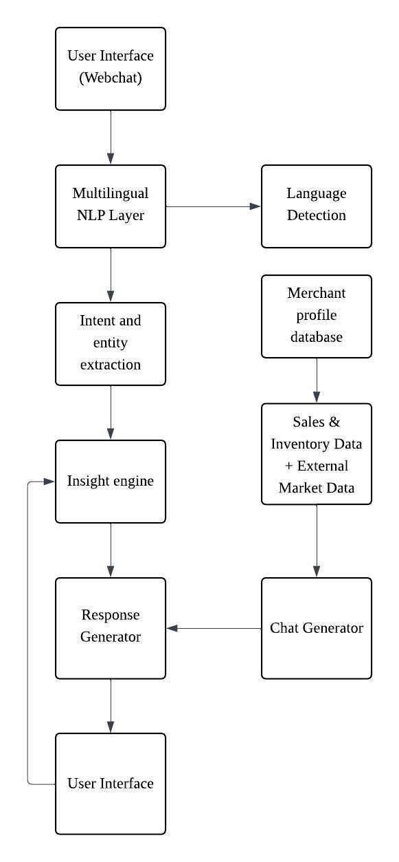
SOLUTION ARCHITECTURE
This architecture outlines how the MEX Assistant processes merchant queries, extracts relevant context, and delivers personalized, real-time insights. It integrates multilingual NLP, merchant profiling, data analytics, and a response generator to provide actionable guidance through a natural chat interface.

Slide 8

03
DATA UTILIZATION

Slide 9
Data sources
"We’ve been provided with clean, structured datasets—items.csv, keywords.csv, merchant.csv, transaction_data.csv, and transaction_items.csv—covering merchant profiles and transactions. These are ready to use, allowing us to focus on building insights, trend analysis, and personalized experiences without spending time on data cleaning."

Slide 10

04
PERSONALIZED STRATEGIES

Slide 11



Personalization strategy
F&B, Retail, Services – different insights matter
Country, urban/rural, language preference
New vs experienced merchants need different guidance

Slide 12

05
INTERACTION DESIGN

Slide 13

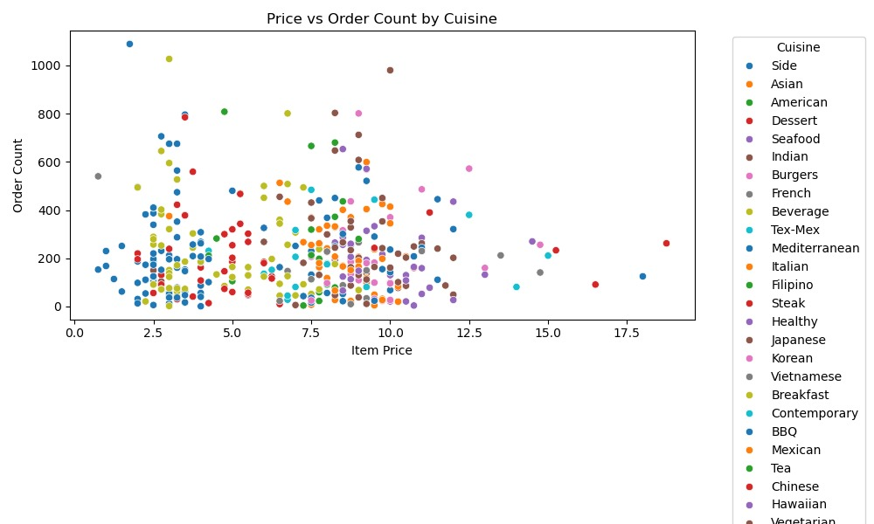
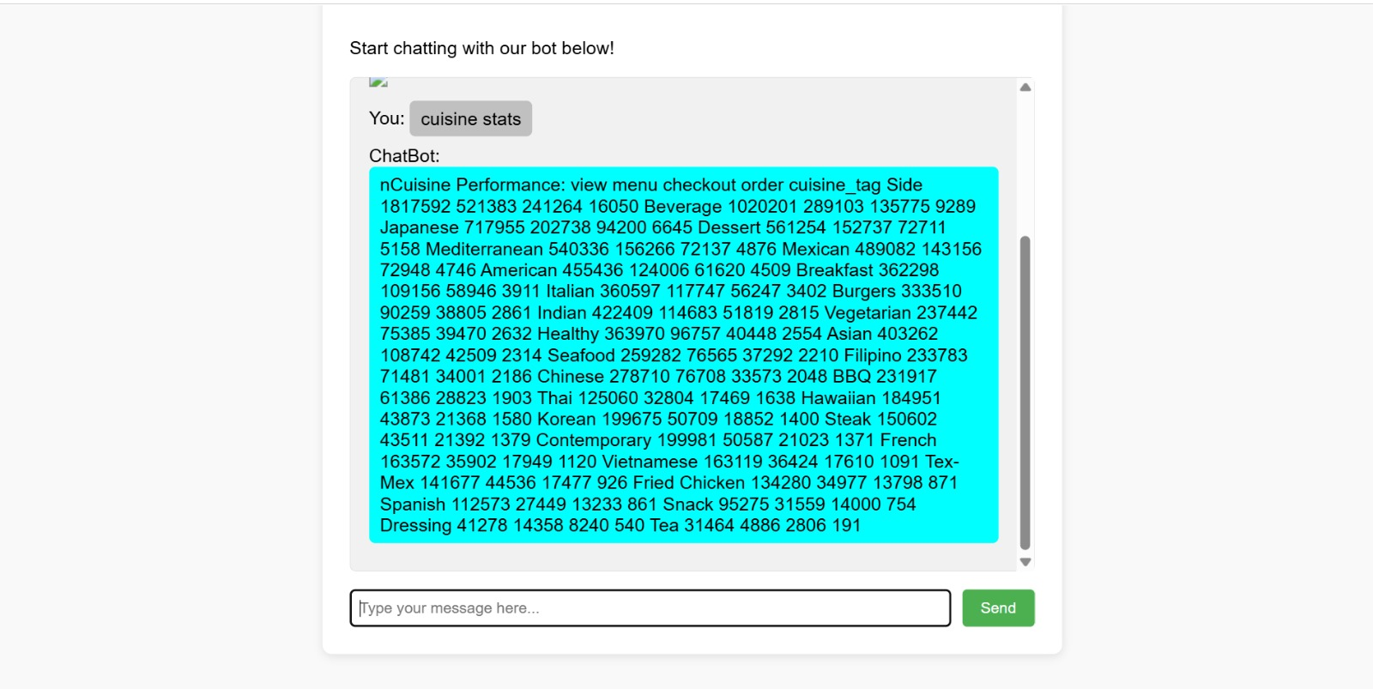
INTERACTION DESIGN
Visual Cards for Insights Simple graphs and icons (bar charts, trend arrows) make data digestible
Mobile-Friendly Design Tailored for small screens with short messages and visual hierarchy.
Fast responses
Chatbot will reply within 1 seconds

Slide 14

06
SAMPLE CHAT CASE

Slide 15
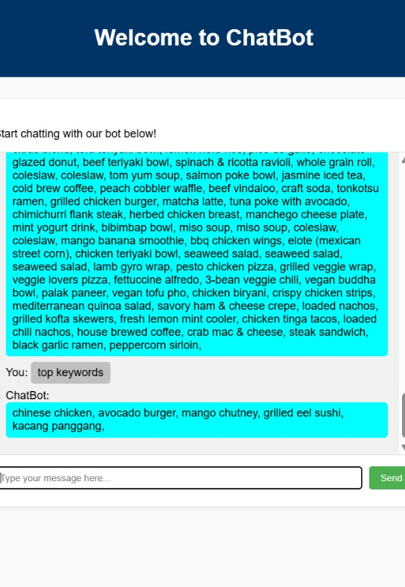
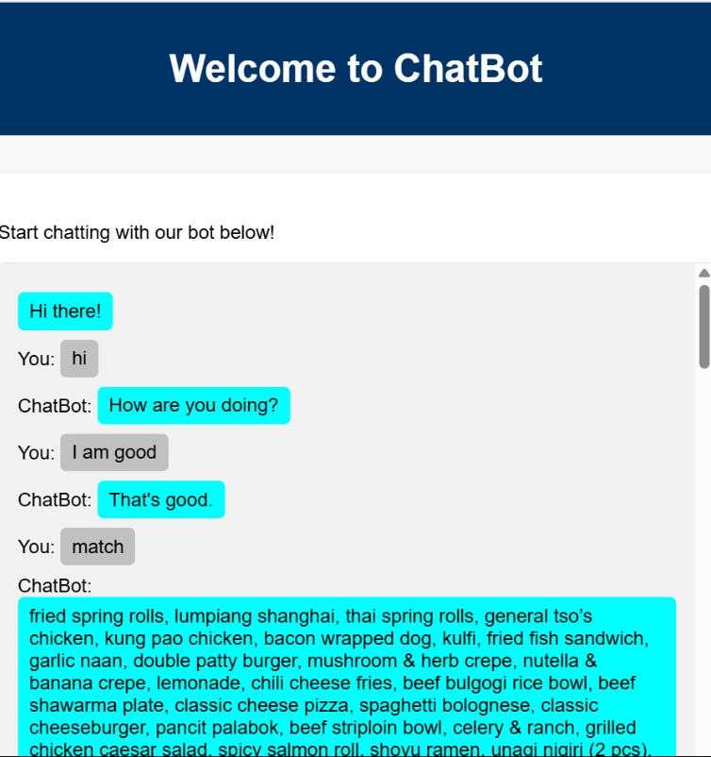
SAMPLE SHOWCASE
This section highlights realistic scenarios where the MEX Assistant delivers immediate value to merchants by providing timely insights through natural, actionable conversations.

